Slide 1
Session 2
Unit 3: First Aid Operations - Part 1
OHCC
SERT Basic Training
Notes:
Session 2 is all about First Aid and we will review situations we may encounter as SERT ERT members.

Slide 2
Session 2 - Unit 3 3 Objectives
Identify life-threatening conditions resulting from trauma including severe bleeding, low body temperature, and airway blockage.
Review correct life saving techniques.
Review basic first-aid care for non-life-threatening injuries.
PM 3-1
SERT Basic Training Unit 3: Disaster First Aid Operations – Part 1 3/28/2021
3-2
Notes:
Following a major disaster, we may be faced with a variety of life-threatening conditions. While we have all completed the American Red Cross Adult First, CPR/AED Aid course, the information we will review may be helpful during an activation. We will review and discuss correct life saving techniques and how we can provide first aid care for non-life-threatening injuries. Note that six SERT members are certified first aid instructor’s so all information shared today are informed, but if outside of the American Red Cross materials are OPINIONS!

Slide 3
Treating Life-Threatening Conditions
Without treatment, severe bleeding and airway obstruction can quickly lead to death.
The first priority of SERT volunteers assisting in disaster first aid operations is to attend to these conditions by controlling bleeding and positioning a patient so they can breathe.
PM 3-2
SERT Basic Training Unit 3: Disaster First Aid Operations – Part 1 3/28/2021
3-3
Notes:
Critical situations --SEVERE BLEEDING--you need to stop the bleed, or the person dies! If the person’s airway is blocked then they cannot breathe, and the person dies! These are situations that require immediate attention and are your FIRST PRIORITY! If this help is requiring more than what you are trained to provide, call for HELP on your radio.

Slide 4
Safety Considerations
Prior to treatment, ensure that both the patient and rescuer are in a safe environment to administer care.
Some questions SERT volunteers should consider:
  Do I feel safe at this spot?
  Should I leave and move to a safer location, or am I able to stay and start providing care immediately?
  If I leave, can I take anyone with me?
PM 3-2
SERT Basic Training Unit 3: Disaster First Aid Operations – Part 1 3/28/2021
3-4
Notes:
Before entering any situation ask yourself “IS IT SAFE?”. If the answer is NO, then don’t go. If the answer is YES, then proceed and when you find a patient ask yourself again, “IS IT SAFE?” to leave the patient here. If YES, it maybe be best not to move the patient depending on their condition. If NO, you need to decide if you can assist the patient in moving or do you need to seek assistance from another.

Slide 5
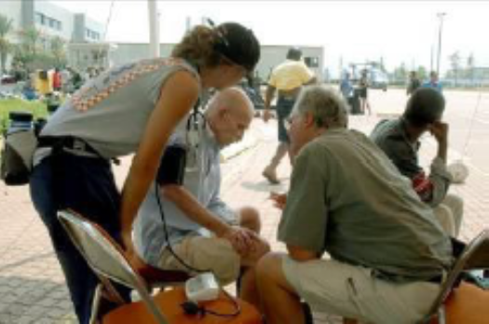
Approaching the Patient
Be sure patient can see you.
Identify yourself
  Your name and name of your organization.
Request permission to treat, if possible. If unconscious permission is assumed.
Respect cultural differences.
Protect patient privacy.
PM 3-2
SERT Basic Training Unit 3: Disaster First Aid Operations – Part 1 3/28/2021
3-5
Notes:
Back to the RED CROSS training. You always start with identifying yourself and that you are with SERT. ALWAYS ask for permission to help the patient. If the patient is unconscious permission is “assumed”.
Some cultural differences may not want you to touch or to even speak to a female without permission. Therefore, you always ask permission to help the patient.

Slide 6
Excessive Bleeding
Stop The Bleed, Hemorrhage Control Training – YouTube
This video is approximately 23 minutes.
3-6
Notes:
This 23-minute video discusses excessive bleeding and how to “Stop The Bleed”. Let’s take a look!

Slide 7
Stages of Severe Bleeding
Stage | Blood Loss | Heart Rate | Blood Pressure | Breath Rate | Patient
I | Less than 15% | Normal (<100 bpm) | Normal | 14-20 | Patient appears normal
II | 15%-40% | Fast (>100 bpm) | Slightly Low | 20-30 | Patient may feel anxious
III | 30%-40% | Very Fast (>120 bpm) | Low | 30-40 | Patient feels confused
IV | Greater than 40% | Critical (>140 bpm) | Critical | >35 | Patient feels lethargic
PM 3-3
SERT Basic Training Unit 3: Disaster First Aid Operations – Part 1 3/28/2021
3-7
Notes:
Bleeding can be challenging. A combination of blood loss, increased heart rate, and increased breath rate helps you identify the severity of blood loss. While we can check the heart rate via taking their pulse, we will NOT be taking someone's blood pressure.

Slide 8
Types of Bleeding (image)
PM 3-3
SERT Basic Training Unit 3: Disaster First Aid Operations – Part 1 3/28/2021
3-8
Notes:
Of the 3-types of bleeding shown here which is the most concerning? Arterial as the blood is coming directly from the heart.

Slide 9
Controlling Bleeding: Direct Pressure
Step 1: Find the source(s),
Step 2: Cover the source,
Step 3: Apply pressure,
Step 4: Maintain pressure until bleeding has stopped.
PM 3-4
SERT Basic Training Unit 3: Disaster First Aid Operations – Part 1 3/28/2021
3-9
Notes:
We follow these 4-steps to control bleeding.

Slide 10
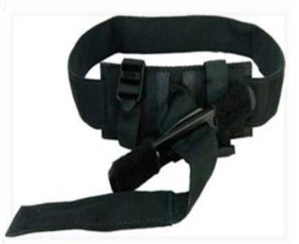
Controlling Bleeding: Tourniquets
Place on injured limb as high as possible,
Pull strap through buckle,
Twist rod until bleeding stops/slows,
Secure the rod,
If bleeding continues, place second tourniquet.
Leave in place until EMS takes over.
PM 3-4/5
SERT Basic Training Unit 3: Disaster First Aid Operations – Part 1 3/28/2021
3-10
Notes:
For an arterial bleed on a LIMB, you may need to apply a tourniquet. These are relativity easy to apply and once in place should only be removed by a medical professional. A best practice is to write the date and time the tourniquet was applied on the device.

Slide 11
Shock
Shock is often difficult to diagnose.
Main signs of shock:
  Rapid and shallow breathing,
  Capillary refill of greater than two seconds,
  Failure to follow simple commands, such as “squeeze my hand.
Symptoms of shock are easily missed. Pay careful attention to your patient.
PM 3-5
SERT Basic Training Unit 3: Disaster First Aid Operations – Part 1 3/28/2021
3-11
Notes:
Shock maybe difficult to diagnose and the onset may develop over time as the patient undergoes changes. Look for rapid and shallow breathing and capillary refill greater than 2-seconds when you squeeze the patients nail on their finger or toe. A patient’s condition can change so you will need to pay careful attention for changes.

Slide 12
Maintaining Body Temperature
Keep the patient warm:
  Remove wet clothing.
  Place something between patient and ground (e.g., cardboard, jacket, blanket).
  Wrap patient with dry layers (e.g., coat, blanket, Mylar emergency blanket).
  Shield patient from wind.
PM 3: 5-6
SERT Basic Training Unit 3: Disaster First Aid Operations – Part 1 3/28/2021
3-12
Notes:
Keeping a patient warm helps in dealing with Shock. If the body gets cold, it can lead to shock. People should be in dry clothing. If you have a patient on the ground, put something between the patient and the ground. Wrap the patient in dry layers and shield them from the wind if possible.

Slide 13
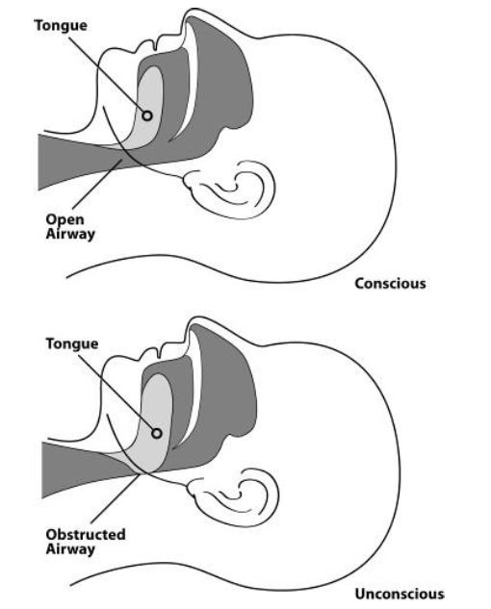
Open vs. Obstructed Airway
SERT Basic Training Unit 3: Disaster First Aid Operations – Part 1 3/28/2021
3-13
Notes:
If the patient can not breathe, they may die. If the patient is not conscious, it maybe as simple as tilting the head back to open the airway.

Slide 14
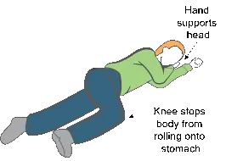
Recovery Position
Body: Laid on its side;
Bottom Arm: Reached outward;
Top Arm: Rest hand on bicep of bottom arm;
Head: Rest on hand;
Legs: Bent slightly;
Chin: Raised forward;
Mouth: Pointed downward.
PM 3-7
SERT Basic Training Unit 3: Disaster First Aid Operations – Part 1 3/28/2021
3-14
Notes:
Repositioning the patient can also aid in keeping the airway open.

Slide 15
Providing Comfort
What can you (or others) do?
  Keep them warm.
  Offer a hand to hold.
  Maintain eye contact.
  Be patient and understanding.
  If you must move on to provide aid to another person, let them know.
PM 3-8
SERT Basic Training Unit 3: Disaster First Aid Operations – Part 1 3/28/2021
3-15
Notes:
Sometimes a patient just needs someone to provide comfort. These are the steps in providing comfort. Remember in the initial stages of a natural disaster assessment, you will not have time to provide comfort.

Slide 16
Treating Burns:
Prevent hypothermia;
Manage pain;
Reduce risk of infection.
PM 3-9
SERT Basic Training Unit 3: Disaster First Aid Operations – Part 1 3/28/2021
3-16
Notes:
You may come across a patient with burns due to a fire, electrical shock or chemical burns. The 3-key things to know about dealing with burns are shown here.

Slide 17
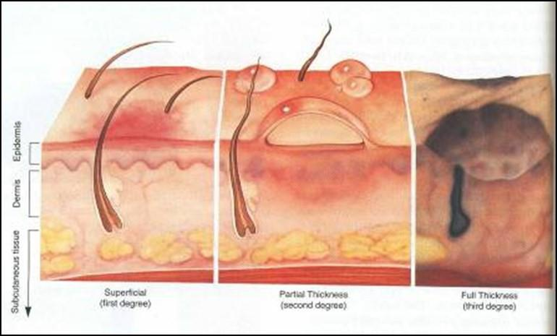
Burn Classifications:
Superficial: epidermis.
Partial Thickness: dermis and epidermis.
Full Thickness: subcutaneous layer and all layers above.
PM 3-9
SERT Basic Training Unit 3: Disaster First Aid Operations – Part 1 3/28/2021
3-17
Notes:
1st degree burns are to the outer layer and may be like a severe sunburn.
2nd degree has blistering.
3rd degree has damage to the underlaying tissue and needs a medical professional help in treating.

Slide 18
Wound Care
Main treatment for wounds:
  Control bleeding;
  Apply dressing and bandage.
Apply dressing and bandage:
  Apply dressing directly to wound;
  Bandage holds dressing in place.
PM 3-11
SERT Basic Training Unit 3: Disaster First Aid Operations – Part 1 3/28/2021
3-18
Notes:
In your SERT backpack, you have a limited supply of bandages to assist patients. You will need to monitor your supplies and do not hesitate to radio in for additional supplies, as necessary.
Always remember to apply direct pressure to bleeding areas and keep it in place until the bleeding stops. Your patient or other neighbor maybe able to assist in keeping the pressure on.

Slide 19
Amputations
If amputated body part is found:
  Save tissue parts, wrapped in clean material and placed in plastic bag;
  Keep tissue parts cool, but NOT directly on ice;
  Keep severed part with survivor.
PM 3-11
SERT Basic Training Unit 3: Disaster First Aid Operations – Part 1 3/28/2021
3-19
Notes:
OK, not a pleasant thought and you are probably looking at a potential tourniquet situation. Follow these steps in dealing with a found body part.

Slide 20
Impaled Objects
When foreign object is impaled in patient’s body:
  Immobilize affected body part;
  Do not attempt to move or remove;
  Try to control bleeding at entrance wound;
  Clean and dress wound, making sure to stabilize impaled object.
PM 3-12
SERT Basic Training Unit 3: Disaster First Aid Operations – Part 1 3/28/2021
3-20
Notes:
During a building collapse a person may be impaled by an object. DO NOT try to remove the object, leave that to the medical professional. Removing the object could lead to internal bleeding.

Slide 21
Fractures, Dislocations, Sprains, Strains
Immobilize injury and joints immediately above and below injury site.
If uncertain of injury type, treat as fracture.
PM 3-12
SERT Basic Training Unit 3: Disaster First Aid Operations – Part 1 3/28/2021
3-21
Notes:
Broken bones are painful, as are dislocations and sprains and strains. Unless there is severe bleeding, you will need to immobilize the injury and report the situation. Then continue to move on with your assessment.

Slide 22
Dislocations
Dislocation is injury to ligaments around a joint:
  It is so severe that it permits separation of bone from its normal position in a joint.
Treatment:
  Immobilize; do NOT relocate.
  Check Pulse, Movement, and Sensation (PMS) before and after splinting/immobilization.
PM 3-13
SERT Basic Training Unit 3: Disaster First Aid Operations – Part 1 3/28/2021
3-22
Notes:
While this will be painful to the patient, DO NOT attempt to relocate the joint! This is a job for a medical professional.

Slide 23
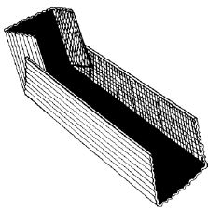
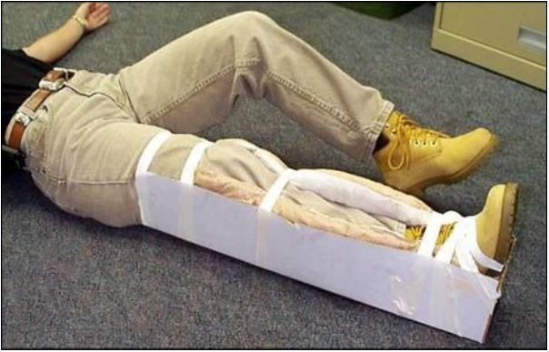
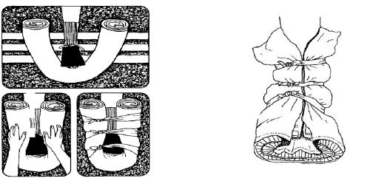
Splinting
PM 3: 14-15
SERT Basic Training Unit 3: Disaster First Aid Operations – Part 1 3/28/2021
3-23
Notes:
Splinting is not hard. You can use a variety of cardboard, rolled newspapers, magazines, towels to form a splint. Then get out your DUCT TAPE and secure the splint in place.

Slide 24
Heat-Related Injuries
Heat cramps
  Muscle spasms brought on by over-exertion in extreme heat.
Heat exhaustion
  Occurs when exercising or working in extreme heat results in loss of body fluids.
Heat stroke
  Survivor’s temperature control system shuts down.
  Body temperature rises so high that brain damage and death may result.
PM 3-17
SERT Basic Training Unit 3: Disaster First Aid Operations – Part 1 3/28/2021
3-24
Notes:
Heat-Related injuries may not be much of a concern here in OHCC. However, we can not rule out a disaster which strikes on a hot Summer’s day. As a responder, you need to make sure you keep hydrated. These are the signs of heat related situations.

Slide 25
Session 2
Unit 3 Summary (Unit 3)
Life-saving measures SERT volunteers can take:
  Control bleeding using direct pressure and/or a tourniquet;
  Maintain normal body temperature;
  Open airway and position patient correctly.
Other injuries that are common after disasters:
  Burns;
  Wounds;
  Amputations and impaled objects;
  Fractures, dislocations, sprains, and strains;
  Heat-related injuries.
PM 3-19
SERT Basic Training Unit 3: Disaster First Aid Operations – Part 1 3/28/2021
3-25
Notes:
Today we have reviewed life-saving measures and other common injuries that may occur following a disaster.

Slide 26
Homework Assignment (Unit 3)
Read units to be covered in next session:
  Session 3
  Unit 4: First Aid Operations, Part 2
Unit 5: Disaster Psychology
SERT Basic Training Unit 3: Disaster First Aid Operations – Part 1 3/28/2021
3-26
Notes:
For your next class continue your readings of Units 4 and 5. Thank you all for your participation.

