Slide 1
Session 4
Unit 6: Fire Safety & Utility Control
Unit 7: Search & Rescue
SERT Basic Training
Notes:
Hello and welcome to the final session of SERT Basic Training. Today we will cover areas other then First Aid. I need to say again your #1 priority is to stay SAFE!

Slide 2
Session 4
Unit 6 & 7 Objectives
Unit 6 Objectives:
Review fire chemistry and characteristics.
Explain the role SERT plays in fire safety and response.
Explain the role SERT plays in utility control.
Unit 7 Objective:
Explain the role SERT plays in search and rescue.
3.
PM 6-1
SERT Basic Training Unit 6: Fire Safety and Utility Controls 3/19/2023
2
Notes:
Unit 6 we will review fire and utility safety.
Unit 7 our role in search and rescue so let’s get started. Do you have your manuals open, section 6 page 1.

Slide 3
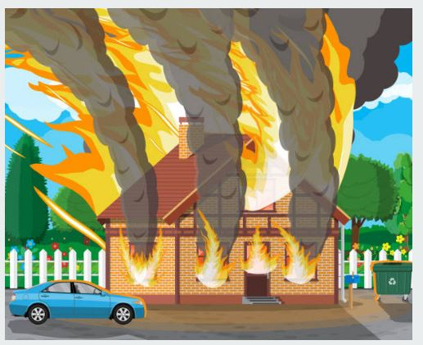
Fire Suppression Safety
INCIDENT COMMANDER DIRECTIVES
Safety of individual SERT Responders is top priority!
SERT Responders will NOT fight fires.
SERT Basic Training Unit 6: Fire Safety and Utility Controls 3/19/2023
3
Notes:
The Incident Commander has directed that SERT Responders will not fight fires.
SERT Responders do not have the personnel resources, training, or equipment to safely suppress a fire.
REMINDERS:
CERT Training includes practice using fire extinguishers. SERT responder training does not include this practice.
SERT responders are not provided with fire extinguishers and using the wrong type of extinguishing agent can cause a fire to reignite and injure both responders and residents.

Slide 4
The Fire Triangle
PM 6-3
SERT Basic Training Unit 6: Fire Safety and Utility Controls 3/19/2023
4
Notes:
For a fire to exist three “elements” are required;
OXYGEN- in the air (~20%),
FUEL – in our community this would most likely be natural gas, building materials, and vegetation.
HEAT - from something as common as arcing electrical connections or as simple as static electricity from the clothes you wear.
When these three elements are in the proper proportions combine a chemical reaction occurs and a fire will burn.
Remove any of the three elements and the chemical reaction will stop and the fire will be extinguished.
Extinguishing a fire by removing the heat or oxygen source by conventional firefighting will allow natural gas to keep flowing.
Once the fire is extinguished, oxygen will return and will combine with natural gas fuel to form two sides of the fire triangle.
Adding the third element can cause a reignition, or in some cases an explosion.

Slide 5
Role of SERT
SERT plays a very important role in fire response by:
  Understanding and following their level of training.
  Practicing the three S’s:
    Safety
    Situational Awareness
    Size-Up
SERT Basic Training Unit 6: Fire Safety and Utility Controls 3/19/2023
5
Notes:
When a SERT Responder encounters a fire, the three S Process should be used –
Safety:
for yourself and residents.
Approach fire from upwind position.
If you can feel heat from the fire, you are too close!
Radio to Command Post to request on-deck responder be sent.
Situational Awareness:
What is burning?
Are the occupants out of the structure?
Remember that garages may contain various chemicals that can react to fire and produce toxic gasses.
Size-Up:
Will the fire jeopardize other areas?
Isolate at least two house either side of structure, include houses in front and in rear of property.
Notify Fire Department Emergency Response via 911.
Notify front and back gate monitor that 911 has been called. Verify address.

Slide 6
Utility Control
SERT Responders should NOT turn-off gas or electrical utilities unless under “controlled” conditions.
Control of these two “hazardous energy” utilities are the responsibility of the homeowner.
Utilities should only be restored under supervision of qualified utility worker.
SERT Basic Training Unit 6: Fire Safety and Utility Controls 3/19/2023
6
Notes:
Utility controls that have not been properly maintained can present a safety hazard to SERT Responders.
“Controlled conditions” mean the SERT responder is completely confident there is no release of natural gas or arcing of electrical connections.
SERT Responders are not provided with the training or resources to make those evaluations.
Homeowners have been provided information during Emergency Preparedness training advising. It is the homeowner's responsibility to know WHERE the utility controls are and HOW to turn them off and on. SERT covers this during the In-Home Safety Survey. That is why it is so important that as many OHCC residents as possible have this information.

Slide 7
Unit 6 Summary
You should have a greater understanding of fire chemistry and characteristics.
You should have a clear understanding the role SERT plays in fire safety and response.
You should be able to state the role SERT plays in utility control.
SERT Basic Training Unit 6: Fire Safety and Utility Controls 3/19/2023
7
Notes:
Do you have any questions regarding the materials we have just covered?

Slide 8
Session 4
Unit 7: Light Search and Rescue Operations
SERT Basic Training
Notes:
Moving on to Unit 7 Light Search and Rescue Operations.

Slide 9
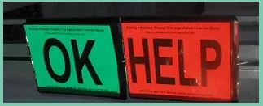
Search and Rescue
SERT Responders will perform a preliminary Life Safety Assessment from the Green OK or Red HELP Signs deployed by the resident.
SERT Basic Training Unit 7: Light Search & Rescue Operations 3/19/2023
9
Notes:
Residents have been instructed through their Emergency Preparedness Training to place the signs in a location visible from the street.
SERT Responders, along with a golf cart driver will drive the street recording status of each address (GREEN, RED, or NO sign) on the damage assessment street.
At the end of each street the SERT Responder will radio report the status where RED signs were identified, or NO signs were observed. (DO NOT stop at HELP signs while doing your assessment, that will be someone else's job.)
If the Infrastructure Damage Assessment has cleared the street, the SITSTAT will notify the Safety Coordinator of those addresses where RED, or NO signs were observed. They will take charge of attempting to contact the occupant for a sitrep.
If there is no Safety Coordinator , or where the street has not been cleared, an on-deck SERT Responder will be dispatched to obtain a sitrep.
A RED or NO sign provides implied consent for SERT Responders to enter property but NOT to enter the dwelling.
SERT Responders are to knock on doors and windows and yell loudly to obtain attention of resident. SERT Responders can also open doors if unlocked (but not enter dwelling) and yell loudly.
If resident responds OK – No Help Needed, the SERT Responder will radio report to SITSTAT that no further assistance is needed, and resume assigned duties.
If resident responds HELP, the SERT Responder will radio report to SITSTAT that assistance is needed; then, standby for a second SERT responder before entering dwelling.
While waiting for a second SERT Responder to arrive the first SERT Responder can perform a “SIZE UP”.
If NO response from resident, the SERT Responder will radio report to SITSTAT and standby for instructions.

Slide 10
Important Reminders
SERT response is primarily information gathering to allow emergency response by professional rescuers.
Interior dwelling search and rescue requires at least THREE qualified and trained responders.
Initial SERT response strategy involves only one trained responder – must wait for additional personnel before making a search and rescue entry.
SERT Basic Training Unit 7: Light Search & Rescue Operations 3/19/2023
10
Notes:
The SERT SAR strategy requires three responders; two to make entry and one immediately outside in a safe area to coordinate and act as the SAFETY OFFICER . However, because of limited OHCC ERT personnel resources, it may not be possible to perform an interior search and rescue.

Slide 11
Deciding to Attempt Rescue
Rescue attempt decisions are based on three factors:
  Risks involved for the rescuer and survivor.
  Greatest good for the greatest number.
  Resources and personnel available.
PM 7-1
SERT Basic Training Unit 7: Light Search & Rescue Operations 3/19/2023
11
Notes:
Your first “operational thought” should always be safety. This is YOUR safety. If you get injured, then you become part of the problem and not the solution.
Your first “operational action” should be to do nothing. That may sound counter-intuitive for a responder, but it provides the maximum amount of safety.
Ask yourself – “What would happen if I did nothing? What would be the outcome?” If the survivor is safe and unharmed, but just unable to exit the structure, then consider the NO ACTION approach and wait for help.

Slide 12
Goals of Search and Rescue
Keep safe the rescuers and survivors;
Get walking wounded out;
Rescue lightly trapped survivors.
PM 7-1
SERT Basic Training Unit 7: Light Search & Rescue Operations 3/19/2023
12
Notes:
BEFORE performing Search & Rescue, determine what resources will be needed once the survivor is rescued.
Determine where survivors will stage and rest while awaiting further help.

Slide 13
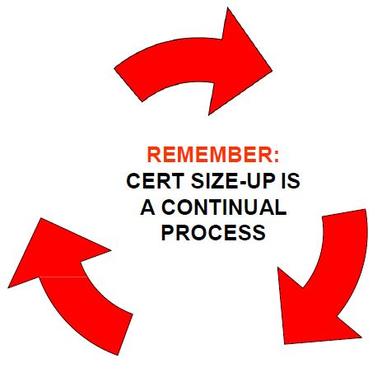
SERT Size-up
Gather Facts
Assess Damage
Consider Probabilities
Assess Your Situation
Establish Priorities
Make Decisions
Develop Plan of Action
Take Action
Evaluate Progress
PM 7-3
SERT Basic Training Unit 7: Light Search & Rescue Operations 3/19/2023
13
Notes:
Depending on the complexity of the Search & Rescue, the entire size-up process can take just a few minutes to a few hours to complete. The decisions made and the actions taken are based on a thorough analysis so take the time necessary.
RESTATE: Always consider the NO ACTION approach first. What are the probable consequences if you take no action? Wait for additional resources or professional help.

Slide 14
Size-up Steps 1 & 2
1. Gather Facts:
  Structural integrity of building
  Occupancy
  Weather
  Hazards
2. Assess & Communicate Damage
  The SERT mission changes if damage is light, moderate, or heavy.
PM 7:5-7
SERT Basic Training Unit 7: Light Search & Rescue Operations 3/19/2023
14
Notes:
Always remember – YOUR safety is FIRST.
Know the differences between Light, Moderate, and Heavy Damage and proceed accordingly. As a reminder, never attempt Search & Rescue if the damage is considered heavy.

Slide 15
Size-up Steps 3 & 4
3 - Consider Probabilities:
  How stable is the situation?
  What secondary factors should be considered?
  What else could go wrong?
  What does it mean for the search and rescue?
4 - Assess Your Situation:
  Is the situation safe enough to continue?
  What risks will rescuers face?
  What resources are needed?
  What resources are available?
PM 7:9-10
SERT Basic Training Unit 7: Light Search & Rescue Operations 3/19/2023
15
Notes:
Step 3: REMEMBER – aftershocks can occur. Damage, especially structural integrity of the building can change. Situational Awareness must be continuous along with ongoing review of the structural integrity.
Step 4: Assess RISK vs GAIN.
Step 4: Resources include personnel, tools, and equipment.
Should you get a second opinion?
If you think it’s unsafe, then it probably is unsafe!

Slide 16

Size-up Steps 5 & 6
5 - Establish Priorities:
  What should be done?
  In what order?
6 - Make Decisions:
  Keep in mind:
    Safety of SERT members,
    Life safety for survivors and others,
    Protection of the environment,
    Protection of property.
PM 7-11
SERT Basic Training Unit 7: Light Search & Rescue Operations 3/19/2023
16
Notes:
Step 5: By this point in the Size-Up process, all the hazards should be identified. It’s important to remember that these hazards must be removed or mitigated before beginning the Search & Rescue.
Step 5: Be mindful of the goal – rescue the greatest number in the shortest amount of time – but not at the expense of your own safety.
Step 6: This is the point in the size-up where you will make decisions based on the priorities established in Step 5.
Step 6: Review sequence of response – life, environment, property.

Slide 17
Size-up Steps 7 & 8
7 - Develop Plan of Action:
  Focus operation on established priorities and decisions.
  Provide documentation to give to responding agencies.
  Provide documentation to become part of SERT records.
8 - Take Action:
  Base action on plan developed during Step 7.
PM 7-12
SERT Basic Training Unit 7: Light Search & Rescue Operations 3/19/2023
17
Notes:
Step 7: The CERT manual suggests that documenting an Action Plan is optional. The SERT ERT IMT wants to make it clear that it is mandatory. The Safety Officer will develop the Plan and decide specifically how the entry team will conduct the operation considering the highest priority tasks first.
Step 8: Implement the Plan.

Slide 18
Size-up Step 9
Evaluate Progress:
  Most critical step.
  Monitor plan’s effectiveness and safety.
  If you see collapsed floors or walls, GET OUT!
PM 7-12
SERT Basic Training Unit 7: Light Search & Rescue Operations 3/19/2023
18
Notes:
Step 9: Follow the Plan. If the Plan cannot be implemented as developed, then STOP and re-evaluate. It may be necessary to leave the structure and report back to the Safety Officer. Be prepared to revise the Plan based on new information.

Slide 19
Search Methodology (1 of 5)
Remain within arm’s reach of another SERT member.
Call out to survivors, “If anyone can hear my voice, come here.”
Ask any survivors who do respond for more information about the building or others who may be trapped.
Survivors might be in shock or confused.
PM 7: 15-16
SERT Basic Training Unit 7: Light Search & Rescue Operations 3/19/2023
19
Notes:
Always use the “Buddy System”.
The responder is most effective and most safe when the responder remains stationary. Stay near an exit and call out for survivors to come to you. The survivors will typically know the layout of the structure better than a responder and can maneuver more easily than a responder.

Slide 20
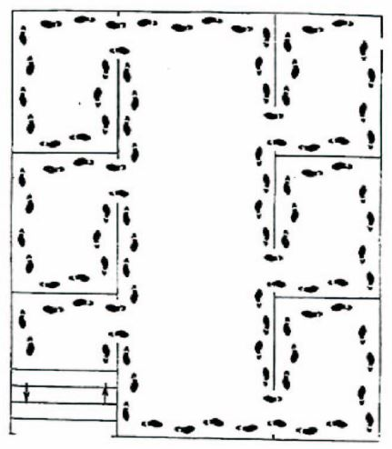
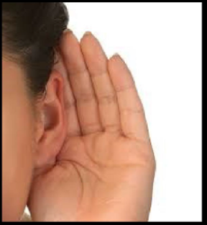
Search Methodology (2 of 5)
Bottom-up/top-down for a multi-story building
Right wall/left wall for a single floor
Stop frequently to listen
PM 7-15
SERT Basic Training Unit 7: Light Search & Rescue Operations 3/19/2023
20
Notes:
The Plan should include the search methodology. Always keep the wall on your RIGHT. Don’t forget to check a closet or a small bathroom.

Slide 21
Search Methodology (4 of 5)
Triangulation allows rescuers to view a location from several perspectives
Keep records of rescued survivors and of those who remain trapped or who are dead
Report information to emergency services personnel
PM 7-15
SERT Basic Training Unit 7: Light Search & Rescue Operations 3/19/2023
21
Notes:
You can also use your flashlight in a darker room and ask if the person can see your light.

Slide 22
Rescue Operations & Precautions
Maintain rescuer safety.
Know your limitations.
Follow safety procedures.
Remove objects and debris to free survivors and create safe rescue environment .
Assess survivors .
Remove survivors.
PM 7: 18-27
SERT Basic Training Unit 7: Light Search & Rescue Operations 3/19/2023
22
Notes:
SAFETY – SAFETY – SAFETY
Continually evaluate your conditions.
Our resources and demographics have BUILT IN limitations.
It’s always appropriate to STOP!

Slide 23

Search Markings
Use BLUE painter tape on exterior of garage door to indicate the house WITHOUT an OK/Help sign has been inspected.
PM 7: 15
SERT Basic Training Unit 7: Light Search & Rescue Operations 3/19/2023
23
Notes:
After the initial damage assessment is completed the ERT member may be assigned to identify those residences WITHOUT an OK/HELP sign. The ERT member will use Blue Painters Tape and place an “X” on the outside garage door to indicate the house has been searched externally for the resident. This will aid ERT members that may need to perform a later Zone search that the home has already been inspected.

Slide 24
Unit 7 Summary (Unit 7)
You should know
  How to decide whether to attempt rescue.
  The objectives of interior and exterior search and rescue.
  How to perform search and rescue size-up.
  Rescue functions.
PM 7:28-29
SERT Basic Training Unit 7: Light Search & Rescue Operations 3/19/2023
24
Notes:
Thank you for participating. We all hope we never have to activate the ERT, but it’s good to know we can!

Slide 25
CONGRATULATIONS!!!
The SERT Club Board of Directors and the Emergency Response Team – Command Staff would like to congratulate you for completing this training program.
Once you have completed your American Red Cross, FEMA materials, and a simulated activation drill you will be Tactical Members.
Go forth and do good work!
Congratulations – Well Done!
25
Notes:
Read the Slide

