Slide 1
Your Safety, Your Responsibility
Meeting will Start In
Presented by OHCC SERT Safety Team
1 PM
Immediately followed by the
OHCC SERT Club Quarterly Membership Meeting
(This meeting is open to all OHCC Residents)
Notes:
Script 2 mins - Tom
Welcome to the OHCC SERT Safety Team presentation of “Your Safety, Your Responsibility”. I am Tom Porter, Vice President of the SERT Club.
Even during the pandemic, SERT will continue to hold our quarterly safety presentations to help all OHCC residents.
As we should realize by now, being prepared is a critical part of staying safe.
We all learned early in the pandemic that TOILET PAPER and DISINFECTANT WIPES are must have items.
Today, we will discuss what else you need to consider must have for keeping yourself safe and prepared!

Slide 2
Your Safety, Your Responsibility Topics we will cover
What does “Your” mean
How OHCC SERT can help
List of things you need
Where to find additional help
Notes:
Script 2 mins - Tom
Have you ever thought about the word YOUR? It has multiple definitions based on how you apply the word. Today, we will challenge you to define YOUR as it applies to you personally.
SERT will provide information and resources you can use to improve your safety.
We will provide you with a list of things you need to be safe and, lastly, where you can find additional resources to help you.

Slide 3
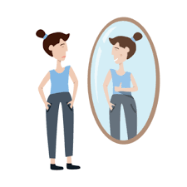
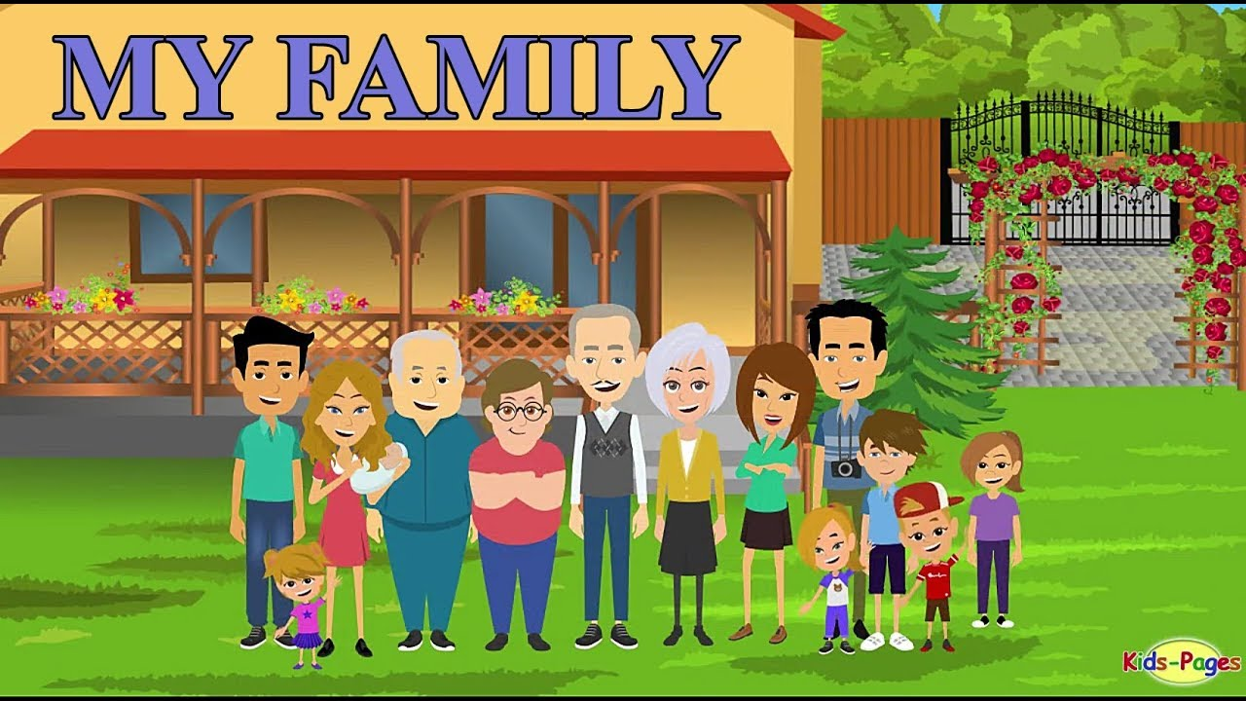
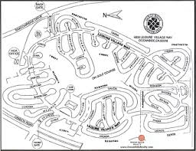
What does “Your” Mean & How SERT Can Help
Your Self
Your Family
Your Street
Your Village
www.tinyurl.com/ohccsert
Your Community
Notes:
Script 3-5 mins - Tom
OHCC SERT is here to help residents learn how to be prepared and stay safe. Neighborhoods that are prepared for emergencies and disaster situations reduce the severity of injuries and trauma, lessen property damage, and save lives. If we all contribute as individuals and work together, we will help develop a stronger community and greatly improve our chances of a better outcome. Our OHCC SERT Club is committed to enhancing your knowledge and skill to help you prepare now! There is a lot of safety related information on the SERT Club website: www.tinyurl.com/ohccsert which is shown on the screen.
Now let’s talk about the word YOUR!
If Your means Self or Family, the SERT Club website contains several resources to assist you in developing an Emergency Preparedness Plan. What is an Emergency Preparedness Plan? We will cover that shortly.
If Your means Street or Village, the SERT Club invites you to join the Neighbor-Helping-Neighbor Street Captain Program. This grassroots movement recruits one or more Captains and Co-Captains per street whose duties are to help their neighbors to help themselves, as well as help others, if they can. This program also helps us know what resources we have living in OHCC. We know we have Doctors, Nurses, Firefighters, EMT, Paramedics, Medics, Law Enforcement Professional, and residents that have current First Aid training certificates from the Red Cross, just to number a few.
In a major disaster or incident our goal is to know if we can tap into this expertise. It will also be helpful to know if a resident has any “special needs” that they would like to share so we can see you get the help you might need as quickly as possible. This is not to pry about your specific medical conditions. It is totally up to you decide what you wish to share, this is totally your call.
If Your means Community, you are talking about the SERT Emergency Response Team, which consists of volunteer community members who are trained to respond and help everyone during an emergency, such as, a natural disaster like an earthquake or major incident.

Slide 4
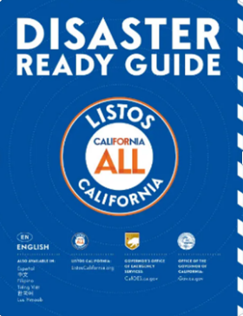
Brochure
CATHOLIC CHARITIES DIOCESE OF SAN DIEGO
San Diego County:
4575-A Mission Gorge Place, San Diego, CA
PH: 619-323-2841
Notes:
Script 1 min – Tom/D
This handout “Disaster Ready Guide” was placed in everyone’s mail tube by OHCC SERT, in partnership with LISTOS CALIFORNIA in their association with the Catholic Charities, Diocese of San Diego and the California Office of Emergency Services. If you have this guide handy please follow along as we go through this information.
It is now my pleasure to introduce Deanna Troncoso of Catholic Charities, Diocese of San Diego, who will take us through this very important material.

Slide 5
Emergency Preparedness
For Older Adults & Their Care Partners
Notes:
Script 3 mins - Deanna
Hi, I’m Deanna Troncoso with Catholic Charities, Diocese of San Diego. Thank you for sharing your time with me to learn some important information and tools on behalf of the Listos California Emergency Preparedness Campaign.
Our past experiences dealing with natural disasters reminded us an emergency can happen at any time and will almost certainly catch us by surprise. The State of California created this campaign to be sure that all San Diegans know what to do and to be ready for a disaster, like a wildfire, earthquake or flood…or even a pandemic.
I’d like to share five simple steps that will help you and your family, friends, and neighbors be alert, be ready and be prepared together. These steps are easy to follow and plan and are life saving when used.

Slide 6
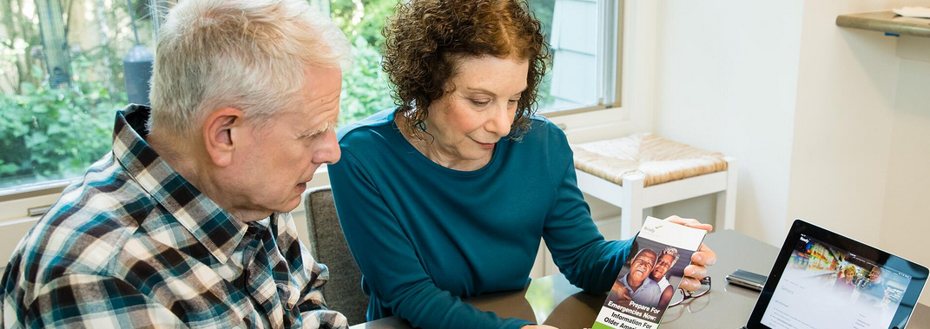
How important is it to be prepared?
5 Ways to Prepare
Benefits
Reduces Fear
Reduces Anxiety
Reduces Losses
Get Alerts
Make A Plan
Pack A Go Bag
Build A Stay Box
Help friends and neighbors get ready
Notes:
SCRIPT 3-5 MIN - Deanna
You may be asking yourself why it is important to be prepared or even think about a possible disaster at all? There are many benefits to being prepared. When communities are prepared for a disaster, fear, anxiety and losses of life and property can be reduced.
Our Listos for California partners with the California Office of Emergency Services (OES) and the State Governor’s office endorsed new disaster preparedness information and tools that can be easily used by anyone to master disaster preparedness.
If we have learned anything from COVID19, it is that we must be prepared. Being prepared is important for you and the people about whom you care . It takes a little thought and planning, but when it’s done you will be ready for any emergency. It only takes five key steps to follow:
Be Aware – Get Alerts to know what to do.
Make a plan – To protect you and the people in your circle.
Get to safety – Be ready to go with everything you need,
Stay safe at home – When you can’t leave.
Help friends and neighbors get ready – Share these Five Steps with others.
Let’s look at how we can be alert, be prepared and be ready together.

Slide 7
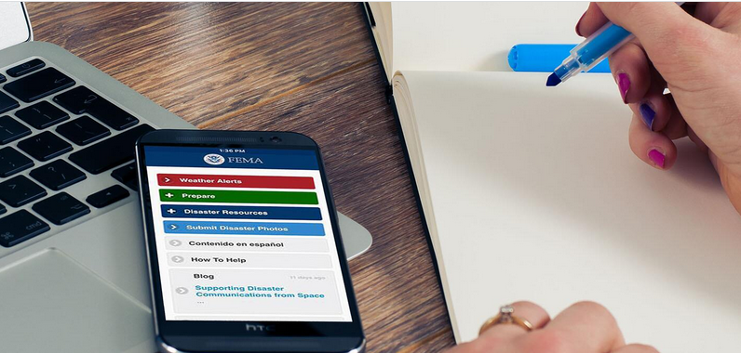
Get Tech Ready...
There are many ways to get alerts, but the California Office of Emergency Services encourages everyone to register for Cal-Alerts.
It’s your direct wireless emergency alert that goes where you go on your cell phone.
Notes:
Script 3 mins - Deanna
There are many ways to get alerts, but the California Office of Emergency Services encourages everyone to register for Cal-Alerts. It’s your direct wireless emergency alert that goes where you go on your cell phone. So get tech ready.
Register at the Ready.gov website. When you register you can get text alerts with instructions on where to go and what to do in a true disaster. Keeping ourselves connected to Wireless Emergency Alert Systems can save us time!
But, if you don’t have access to text or a cell phone, don’t despair – you can
Listen to the news on the radio (like KOGO 600AM) for real-time updates,
Dial 211 from any landline to get news on evacuation routes and shelters.
To learn more about Emergency Alerts visit the OHCC SERT Club website at www.tinyurl.com/ohccsert

Slide 8
Get Alerts in Two Ways
Digital or Text Alerts​
Local News or Landline Contacts
https://www.readysandiego.org/​
CalAlerts.org
Notes:
Script 1 min - Deanna
Sign up for Wireless Emergency Alerts (WEAs) today.
It's easy when you go to the CalAlerts.org website, or you can register locally for alerts at www.readysandiego.org
Register today for text alerts that gives you instructions during a real emergency.

Slide 9
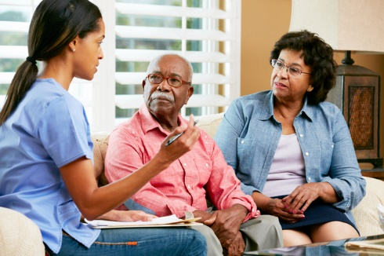
MAKE A PLAN
HOW WILL YOU CONTACT THE PEOPLE IN YOUR CIRCLE?
WILL YOU NEED TO GO OR STAY?
WHAT EQUIPMENT OR SUPPLIES DO YOU NEED?
DO YOU HAVE AN EVACUATION PLAN & MEETING PLACE?
WHAT ABOUT YOUR PETS?
Will you need shelter?
Notes:
Script 3 mins - Deanna
There are many questions to consider when planning your evacuation. Have the conversation with those living with you in your home and those who visit with you regularly.
HOW WILL YOU CONTACT YOUR PEOPLE IN YOUR CIRCLE?
WILL YOU NEED TO GO OR STAY?
WHAT EQUIPMENT OR SUPPLIES DO YOU NEED?
DO YOU HAVE AN EVACUATION PLAN & MEETING PLACE?
WHAT ABOUT YOUR PETS?
Will you need shelter?
(Review slide point questions above, then answer them with details below.)
Get familiar with different ways to escape during an emergency: Might you be able to walk or drive to safety?
Your home might not be safe, use Alert San Diego or 211 to find public shelters near you.
Practice your evacuation plan with others who will go with you. In that way, you will know how to stay together during a real emergency!

Slide 10
PLAN YOUR EVACUATION
Become familiar with different ways to escape during an emergency: Is the area safe to walk or drive?
Your might not be able to stay safely in your home: research public shelters near you. Call 211 for help.
Review your evacuation plan often and update the people in your circle.
Practice often, so you will know what to take and where to go during a real emergency!
Notes:
Script 3 mins - Deanna
Review the questions you considered when planning for your evacuation including a caregiver, if you have one:
HOW WILL YOU CONTACT YOUR CIRCLE OF PEOPLE?
WILL YOU NEED TO GO OR STAY?
WHAT EQUIPMENT OR SUPPLIES DO YOU NEED?
DO YOU HAVE AN EVACUATION PLAN & MEETING PLACE?
WHAT ABOUT YOUR PETS?
Will you need shelter?
(Review slide point questions above, then answer them with details below.)
Become familiar with different ways to escape during an emergency: Is the area safe to walk or drive?
Your home might not be safe, use Alert San Diego or 211 to find public shelters near you.
Practice your evacuation plan with the people who will go with you. That way, you will know how to stay together during a real emergency.

Slide 11
Notes:
Script 3 mins - Deanna
You need to have a drawing of your home’s floor plan. It doesn’t have to be exact, draw one by hand showing all rooms, doors and windows. If you have a second floor you need to include a drawing of this floor, as well.
In an emergency, you need to identify TWO Exits per room, if possible. This may be a door or a window. Keep in mind any physical limitation you may have and remember, in an emergency, like a house fire, the speed of getting out is important. If you are upstairs and your path is blocked in getting downstairs, you need to have a plan to get down to ground level.

Slide 12
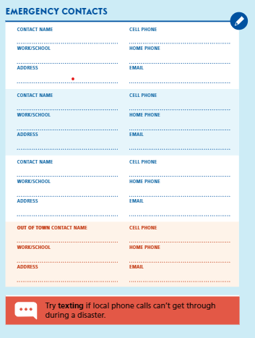
PLAN TO CONNECT & PROTECT
Shirley Jones
PACE Supervisor
Rosalinda Gonzalez
Sister
Think about the people in your circle.
Who do you call in an emergency?
Do you need to make copies?
Is it better to have a contact list in email form or as text contact?
Dr. Chen (760) 555-5555
BEST MEDICAL CENTER
San Diego, CA
Michael Jimenez (209) 811-1111
Super 8 Motor Center
Phoenix, AZ
Notes:
Script 3 mins - Deanna
Make a plan to connect and protect; think about the people in your circle. It is important to create an emergency plan that can work for you. Build a network of support around you in case you need help.
Consider if you have a speech or hearing disability; it is important for you to be able to communicate with others when there is an emergency, and you must seek safety.
Keep your list of contacts on the refrigerator or any place that is clearly visible to others. Keep a copy with you wherever you go.
Sometimes cell phones don’t work during a disaster, like an earthquake or severe storm, but text messages still do. It’s good to keep extra copies of this list as text contacts to send a text to the people in your circle.
Also in an emergency, telephone and cell service may be jammed. It is BEST if you can send a TEXT MESSAGE to someone OUT OF STATE to let them know your status.
Now that we have our plan to connect, let’s talk more about it!

Slide 13
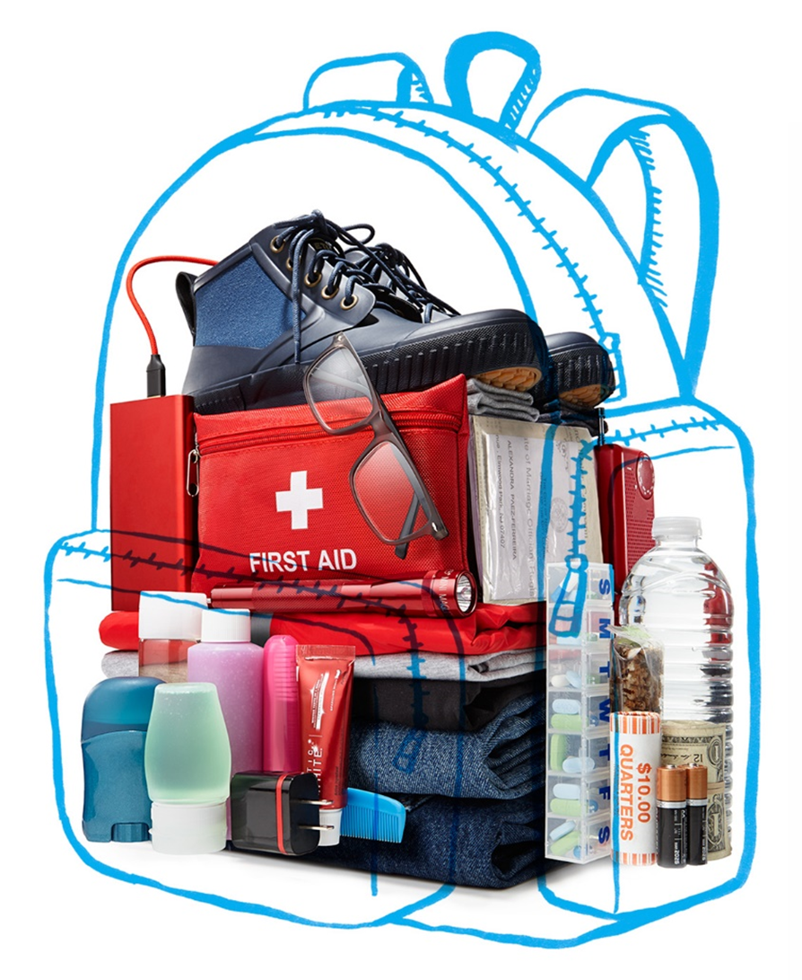
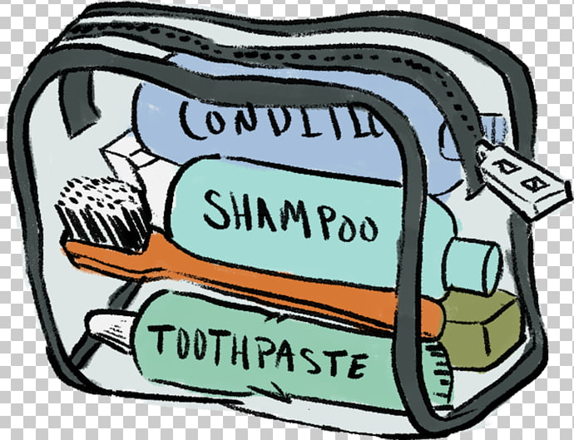
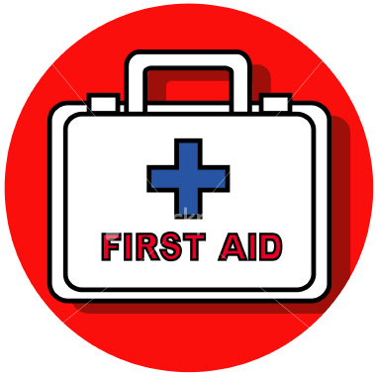
Have My Supplies Ready
Food and Water
Extra eyeglasses
Extra Medication (list meds,
dosages, & pharmacist phone#)
Copies of important documents in a zip-lock bag (licenses, IDs, Insurance, etc.)
Cash (Small bills/ Coins)
Pet Supplies
Radio
Go Bag
3 Days
Extra batteries (flashlight,
pump, hearing aids, or BS/BP monitor)
First Aid KIT
Map (Evacuation Routes)
Personal care items
Clothes, shoes, hat, mask, gloves
Blanket
Notes:
Script 5-10 Mins - Deanna
The perfect bag Think small and portable. A backpack or diaper bag is ideal, but a lightweight suitcase with wheels will also do. Just remember, you may literally be running with it.
2. Clothing Pack a few days’ worth. Include layers you can add or remove, plus lightweight rain gear and waterproof boots.
3. Personal needs While getting yourself or a loved one ready for a typical day, list all toiletries used (travel size), eyeglasses, body wipes / diapers, multipurpose utensils with knife and a can opener are great to have.
4. Your meds / doctors contact information Pack at least three days of each prescription with pharmacy contact numbers. Have portable versions of oxygen / insulin, if needed. Include a list of all your doctors and their contact information. A copy of your Vial of Life form is great!
5. Basic electronics / equipment Pack extra phone chargers with a portable battery pack, a long-lasting LED flashlight, hand-cranked or battery-operated AM/FM radio, extra batteries (including hearing aids), think about medical equipment, oxygen/insulin pumps, etc.
6. Food and drink Bottled water and some packaged food, is essential. You need a minimum of 1-gallon of water per person, per day!
7. Cash In addition to enough money for a few days, include small bills and a roll of quarters. If you need to buy something out of a vending machine, you don’t want to start asking equally desperate strangers for change.
8. Paperwork Fill a zip-top waterproof bag with photocopies of your birth certificate; driver’s license; Social Security and Medicare cards; power of attorney and will; any marriage, adoption or naturalization certificates; proof of address; insurance, medical and immunization records; and information about your credit and ATM cards.

Slide 14
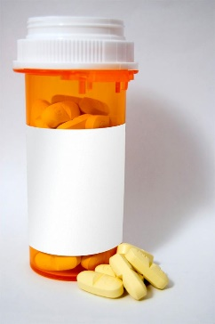
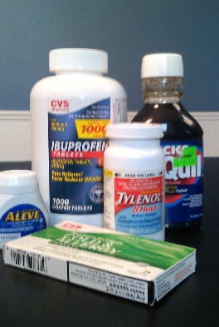
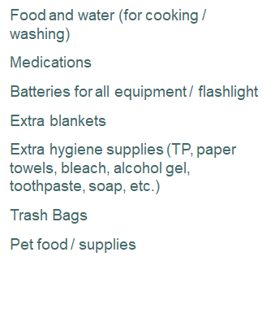
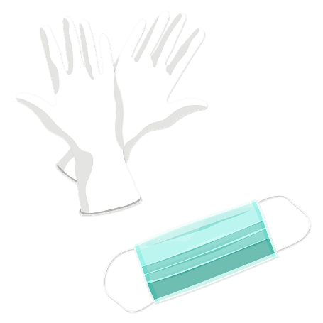
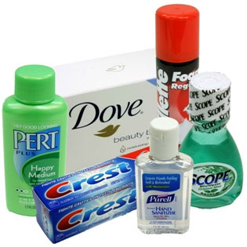
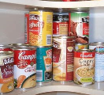
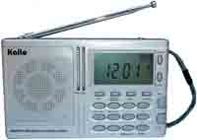
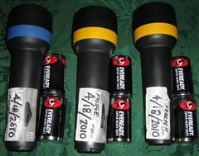
Keep Your Stay Box Ready
Plan on 10-14 days in case you can’t leave.
Notes:
Script 3 mins - Deanna
Can be done as a conversation activity – What would you put in your Stay Box? What we learned since the beginning of COVID-19, THERE ARE SOME ESSENTIALS that cannot be avoided if you have to stay 10-14 days or more.
If the power is out:
Portable radio w/ batteries (to access alerts)
If the tap water is contaminated - Extra food and water (for cooking, cleaning).
If the power or gas is out - Flashlights and extra portable radio, for access to alerts if power is out, extra blankets, and canned goods for cooking. (NO CANDLES!)
If the water system is contaminated:
Bleach, paper towels, paper eating supplies, gloves, baby wipes
If you cannot leave for at least 10 days:
Extra WATER, plan on 1-gallon, per person, per day. Don’t forget water for your pet(s).
Extra food, snacks and hygiene supplies
Extra medications (Prescription and OTC)
Extra batteries for all equipment
Trash Bags
Pet food / supplies
Books / magazines

Slide 15
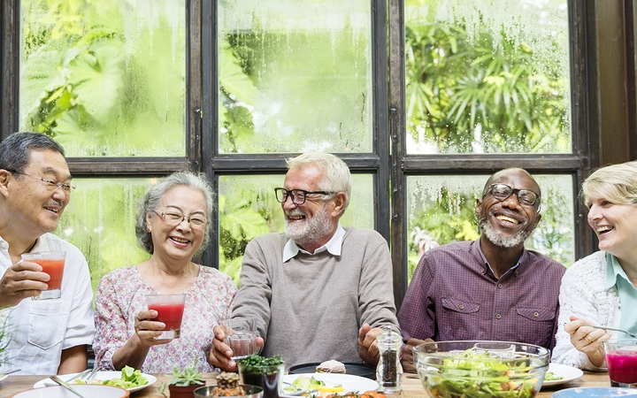
Share These Five Steps With Your Family, Friends, and Neighbors
Notes:
Script 3 mins - Deanna
It is important to remember in regional emergencies that firefighters and paramedics cannot help everyone in need right away. So, we must be ready ourselves, as well as those around us for, at least, 72 hours (3-days).
We encourage you to share these 5 steps we talked about today and also think about neighbors, family and caregiver. If others know what you plan, then they can take care of themselves, too. Care partners and older adults should talk about their plan and practice regularly.
Keep contacts or evacuation information where you can find it quickly; have your go bag ready; sign up now so that your local alert system while provide you with immediate disaster information when you need it; and most important, be ready!

Slide 16
Join the Virtual Movement and Share Today!!
Start today by following these five tips and be prepared in case of any natural disaster.
For more information visit:
OHCC SERT Club
www.tinyurl.com/ohccsertand
Listos
https://ccdsd.org/listos
Notes:
Script 1 min – Deanna
Staying connected in an emergency is important. Preparing TODAY could save your life, and the lives of others. There are many resources available to you on the SERT website and the Listos website shown here.

Slide 17
Copies of this presentation are available on the OHCC SERT Webpage: tinyurl.com/ohccsert under TRAINING Safety Committee Presentations
Thank You
Notes:
Script 1 min – Tom
Thank you, Deanna, for all your wonderful information and thanks all of you for joining us on this SERT Zoom Safety Presentation.
If you have a question regarding any of what you have seen please send us your question via the CHAT Button at on your ZOOM meeting screen. We will respond with 24-hours.
Please stay for the OHCC SERT Club virtual membership meeting to learn more about the SERT Club which will start in 5-minutes.

Slide 18
SERT Club Meeting will start in 5-minutes (Don’t go away)

